Slide 1
Data Modeling
Chapter 7_1
7 - ‹#›
PowerPoint Presentation for Dennis, Wixom, & Roth Systems Analysis and Design, 3rd Edition
Copyright 2006 © John Wiley & Sons, Inc. All rights reserved.
.
Notes:
‹#›

Slide 2
Key Definitions
Data model
A formal way of representing the data that are used and created by a business system
Shows the people, places and things about which data is captured and the relationships among them.
Logical data model
shows the organization of data without indicating how it is stored, created, or manipulated.
7 - ‹#›
PowerPoint Presentation for Dennis, Wixom, & Roth Systems Analysis and Design, 3rd Edition
Copyright 2006 © John Wiley & Sons, Inc. All rights reserved.
.

Slide 3
Key Definitions
Physical data model
shows how the data will actually be stored in databases or files.
Normalization is the process analysts use to validate data models.
Data models should balance with process models
7 - ‹#›
PowerPoint Presentation for Dennis, Wixom, & Roth Systems Analysis and Design, 3rd Edition
Copyright 2006 © John Wiley & Sons, Inc. All rights reserved.
.

Slide 4
THE ENTITY-RELATIONSHIP DIAGRAM (ERD)
7 - ‹#›
PowerPoint Presentation for Dennis, Wixom, & Roth Systems Analysis and Design, 3rd Edition
Copyright 2006 © John Wiley & Sons, Inc. All rights reserved.
.
Notes:
‹#›

Slide 5
What Is an ERD?
A model that identifies the entities that exist in a system and the relationships between those entities
A picture showing the information created, stored, and used by a business system.
Lines drawn between entities show relationships among the data
High level business rules are also shown
7 - ‹#›
PowerPoint Presentation for Dennis, Wixom, & Roth Systems Analysis and Design, 3rd Edition
Copyright 2006 © John Wiley & Sons, Inc. All rights reserved.
.

Slide 6
Purposes of ERD
An ERD serves several purposes
The database analyst/designer gains a better understanding of the information to be contained in the database through the process of constructing the ERD.
The ERD serves as a documentation tool.
Finally, the ERD is used to communicate the logical structure of the database to users. In particular, the ERD effectively communicates the logic of the database to users.

Slide 7
Using the ERD to Show Business Rules
Business rules are constraints that are followed when the system is in operation.
ERD symbols can show when one instance of an entity must exist for an instance of another to exist
A doctor must exist before appointments for the doctor can be made
7 - ‹#›
PowerPoint Presentation for Dennis, Wixom, & Roth Systems Analysis and Design, 3rd Edition
Copyright 2006 © John Wiley & Sons, Inc. All rights reserved.
.

Slide 8
Using the ERD to Show Business Rules
ERD symbols can show when one instance of an entity can be related to only one or many instances of another entity
One doctor can have many patients; each patient may have only one primary doctor
ERD symbols show when the existence of an entity instance is optional for a related entity instance
A patient may or may not have insurance coverage
7 - ‹#›
PowerPoint Presentation for Dennis, Wixom, & Roth Systems Analysis and Design, 3rd Edition
Copyright 2006 © John Wiley & Sons, Inc. All rights reserved.
.

Slide 9
Components of an ERD
An ERD typically consists of four different graphical components:
1. Entity
2. Relationship
3. Cardinality
4. Attribute

Slide 10
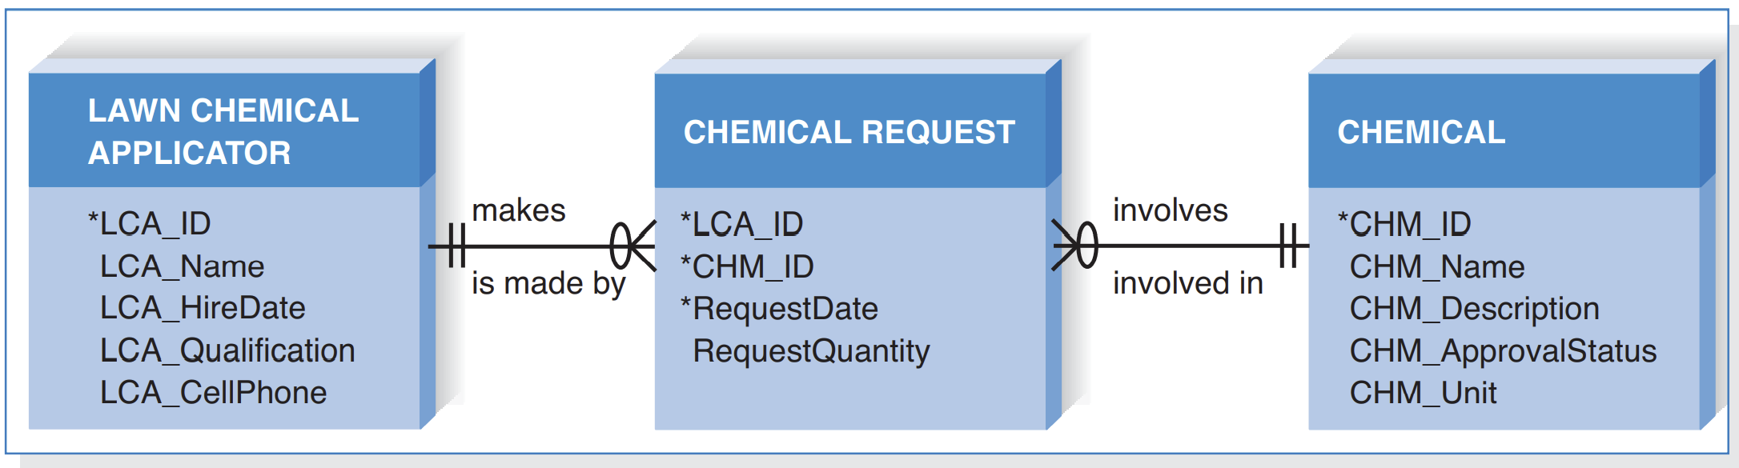
Chemical Request ERD
An ERD Example
7 - ‹#›
PowerPoint Presentation for Dennis, Wixom, & Roth Systems Analysis and Design, 3rd Edition
Copyright 2006 © John Wiley & Sons, Inc. All rights reserved.
.

Slide 11
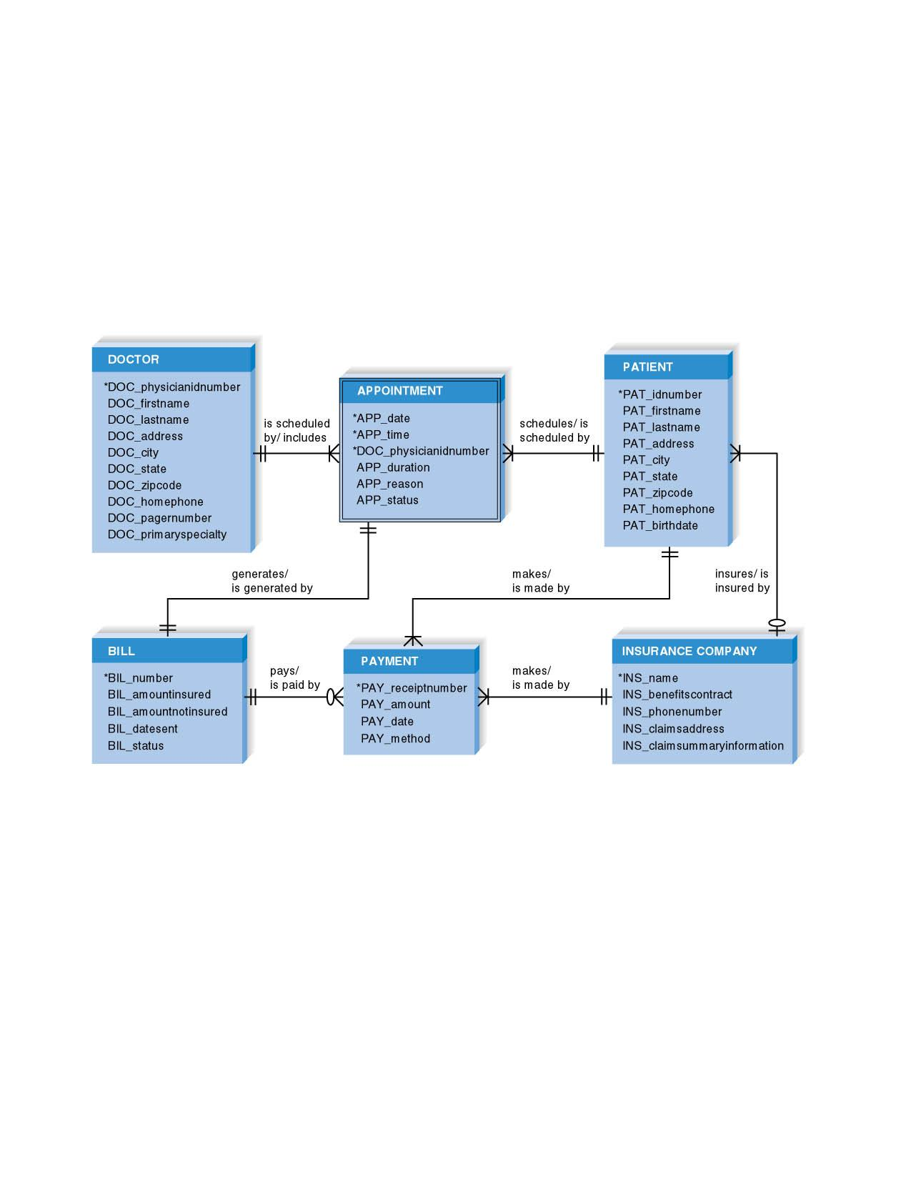
Another ERD Example
PowerPoint Presentation for Dennis, Wixom, & Roth Systems Analysis and Design, 3rd Edition
Copyright 2006 © John Wiley & Sons, Inc. All rights reserved.
.

Slide 12
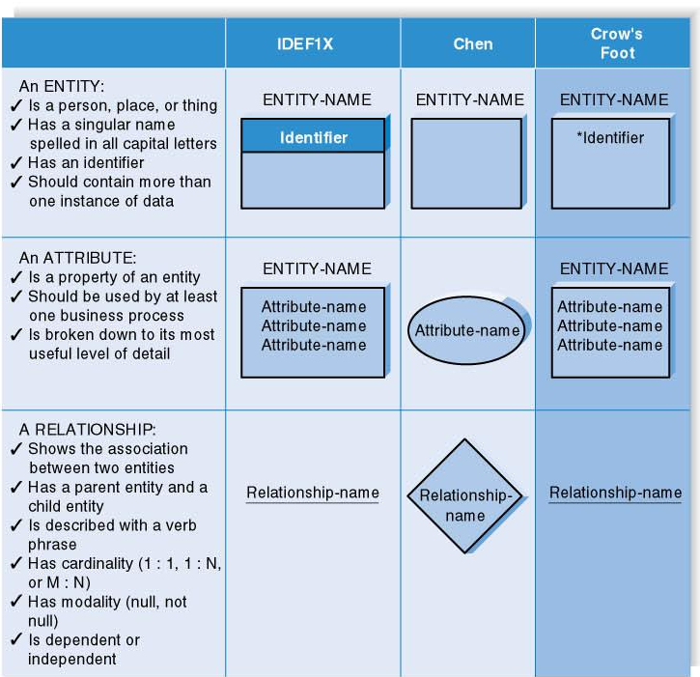
ERD Elements
7 - ‹#›
PowerPoint Presentation for Dennis, Wixom, & Roth Systems Analysis and Design, 3rd Edition
Copyright 2006 © John Wiley & Sons, Inc. All rights reserved.
.

Slide 13
Entity
A person, place, event, or thing about which data is collected
any thing which is likely to be of interest in the context of your system. For example;
it could be a “real world” entity such as a car
it could be a business entity such as a rental agreement
Must be multiple occurrences to be an entity
Example: If a firm has only one warehouse, the warehouse is not an entity. However, if the firm has several warehouses, the warehouse could be an entity if the firm wants to store data about each warehouse instance.
7 - ‹#›
PowerPoint Presentation for Dennis, Wixom, & Roth Systems Analysis and Design, 3rd Edition
Copyright 2006 © John Wiley & Sons, Inc. All rights reserved.
.

Slide 14
choosing entities
In order for something to be worth modelling as an entity it should have the following properties:
the user is interested in its properties – it is important to the system being studied
there are many instances of the same entity type (usually)
all instances of the type have the same set of properties
it is uniquely identifiable in some way

Slide 15
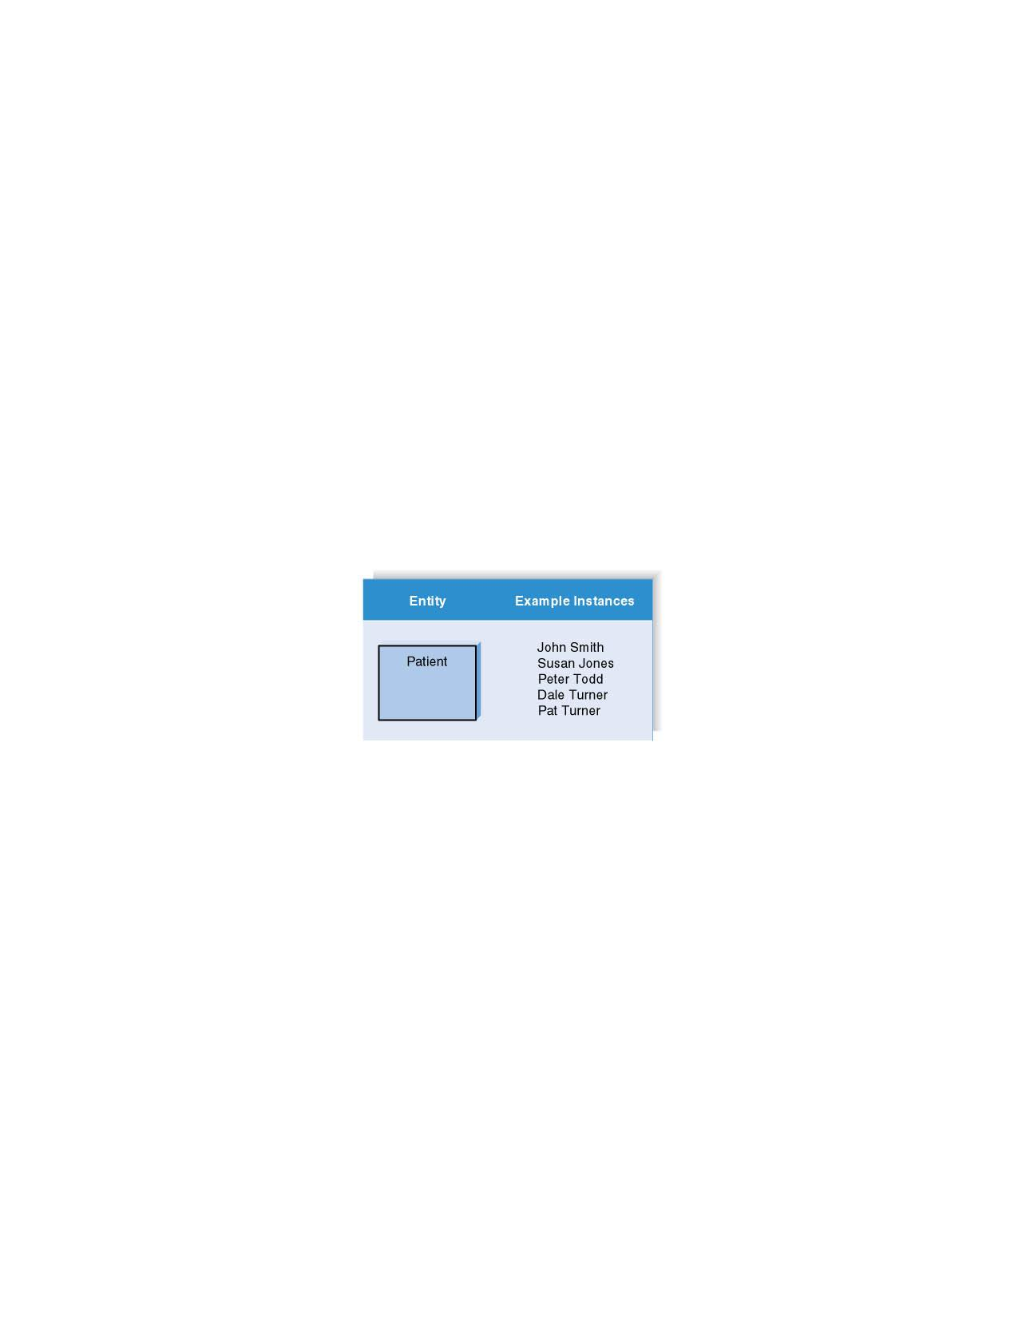
Entities and Instances
7 - ‹#›
PowerPoint Presentation for Dennis, Wixom, & Roth Systems Analysis and Design, 3rd Edition
Copyright 2006 © John Wiley & Sons, Inc. All rights reserved.
.

Slide 16
Attributes
Information captured about an entity
are the properties which describe the entity
for example a car has the attributes: colour, capacity, model …
more precisely we can say that every entity of type car will have attribute values for each of those attributes
e.g.. yellow, 1275cc, mini
Only those used by the organization should be included in the model
Attribute names are nouns
Sometimes entity name is added at the beginning of the attribute name for clarity
7 - ‹#›

Slide 17
Identifiers
An identifier is an attribute (or group of attributes) which uniquely identifies an entity instance
For example, a car is uniquely identified by a registration number
(is it always?)
Concatenated identifier consists of several attributes
An identifier may be ‘artificial,’ such as creating an ID number
7 - ‹#›
PowerPoint Presentation for Dennis, Wixom, & Roth Systems Analysis and Design, 3rd Edition
Copyright 2006 © John Wiley & Sons, Inc. All rights reserved.
.

Slide 18
Relationships
A relationship is an association between two entities
For example there is a relationship between a car and the person that owns it
More precisely, we model a relationship type “owns” between a person type and a car type
Relationships should have active verb names
Relationships go in both directions
Each combination of entities needs to be examined to see if there is a relationship between them. There are two approaches to this: entity grid (or matrix) and building the diagram directly
7 - ‹#›
PowerPoint Presentation for Dennis, Wixom, & Roth Systems Analysis and Design, 3rd Edition
Copyright 2006 © John Wiley & Sons, Inc. All rights reserved.
.

Slide 19
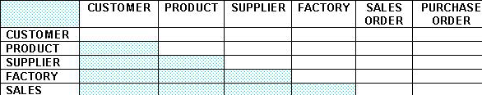
entity grid
A rigorous approach which uses a grid to force analysis of every pair entities and determine the relationship between them
Once the entities have been selected they are drawn up on a grid
The bottom left corner of the grid is hatched to avoid considering relationships twice

Slide 20
Classification of Relationship
Optional Relationship
An Employee may or may not be assigned to a Department
A Patient may or may not be assigned to a Bed
Mandatory Relationship
Every Course must be taught by at least one Teacher
Every mother have at least a Child

Slide 21
Cardinality
refers to the number of times instances in one entity can be related to instances in another entity
Minimum Cardinality
If zero, then optional
If one or more, then mandatory
Maximum Cardinality
The maximum number
7 - ‹#›
PowerPoint Presentation for Dennis, Wixom, & Roth Systems Analysis and Design, 3rd Edition
Copyright 2006 © John Wiley & Sons, Inc. All rights reserved.
.

Slide 22
Cardinality constraints
One instance in an entity refers to one and only one instance in the related entity (1:1)
One instance in an entity refers to one or more instances in the related entity (1:N)
One or more instances in an entity refer to one or more instances in the related entity (M:N)

Slide 23
Cardinality constraints_examples
each customer has one and only one account and an account belongs to only one customer (1:1)
a lecturer is employed by one faculty; a faculty employs many lecturers (1:M)
a student studies many modules, a module is studied by many students (M:M)
7 - ‹#›
PowerPoint Presentation for Dennis, Wixom, & Roth Systems Analysis and Design, 3rd Edition
Copyright 2006 © John Wiley & Sons, Inc. All rights reserved.
.

Slide 24
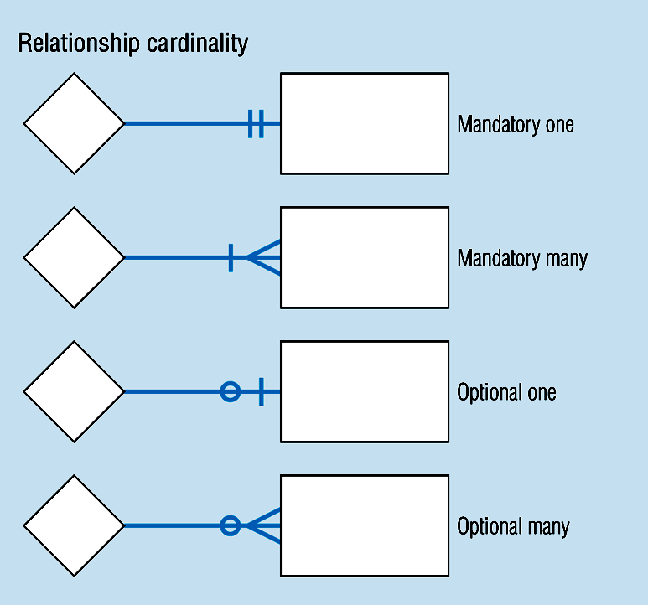
Cardinality Constraints

Slide 25
Cardinality Constraints Example
In our model, we wish to indicate that each school may enroll many students, or may not enroll any students at all.
We also wish to indicate that each student attends exactly one school. The following diagram indicates this optionality and cardinality:

Slide 26
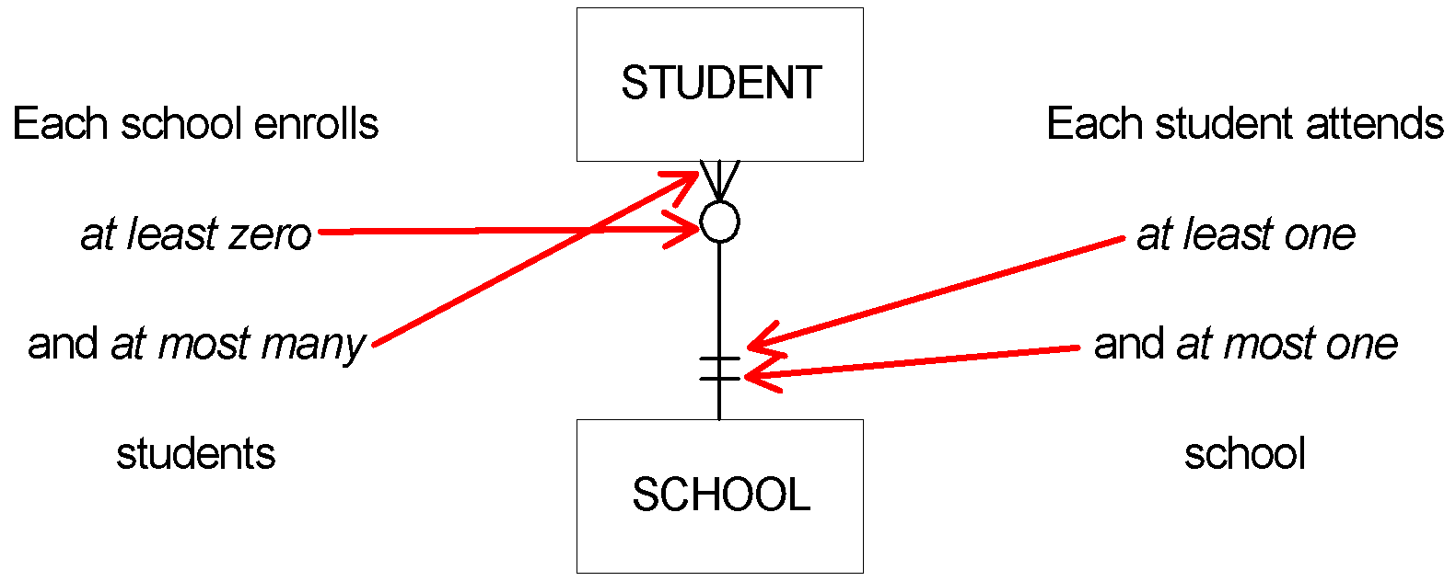
Cardinality Constraints Example (Contd.)

Slide 27
Your Turn
A wealthy businessman owns a large number of paintings that he loans to museums all over the world. He is interested in setting up a system that records what he loans to whom so that he doesn’t lose track of his investments.
He would like to keep information about the paintings that he owns as well as the artists who painted them. He also wants to track the various museums that reserve his art, along with the actual reservations. Obviously, artists are associated with paintings, paintings are associated with reservations, and reservations are associated with museums.
7 - ‹#›
PowerPoint Presentation for Dennis, Wixom, & Roth Systems Analysis and Design, 3rd Edition
Copyright 2006 © John Wiley & Sons, Inc. All rights reserved.
.

Slide 28
Your Turn - Questions
Draw the four entities that belong on this data model
2. Provide some basic attributes for each entity, and
select an identifier, if possible.
3. Draw the appropriate relationships between the entities and label
them.
4. What is the cardinality for each relationship? Depict this on your
drawing.
5. What is the modality for each relationship? Depict this on your
drawing.
6. List two business rules that are communicated by your ERD
7 - ‹#›
PowerPoint Presentation for Dennis, Wixom, & Roth Systems Analysis and Design, 3rd Edition
Copyright 2006 © John Wiley & Sons, Inc. All rights reserved.
.

Slide 29
The Data Dictionary and Metadata
Metadata is information stored about components of the data model
Metadata is stored in the data dictionary so it can be shared by developers and users throughout the SDLC
A complete, shareable data dictionary helps improve the quality of the system under development
7 - ‹#›
PowerPoint Presentation for Dennis, Wixom, & Roth Systems Analysis and Design, 3rd Edition
Copyright 2006 © John Wiley & Sons, Inc. All rights reserved.
.

Slide 30
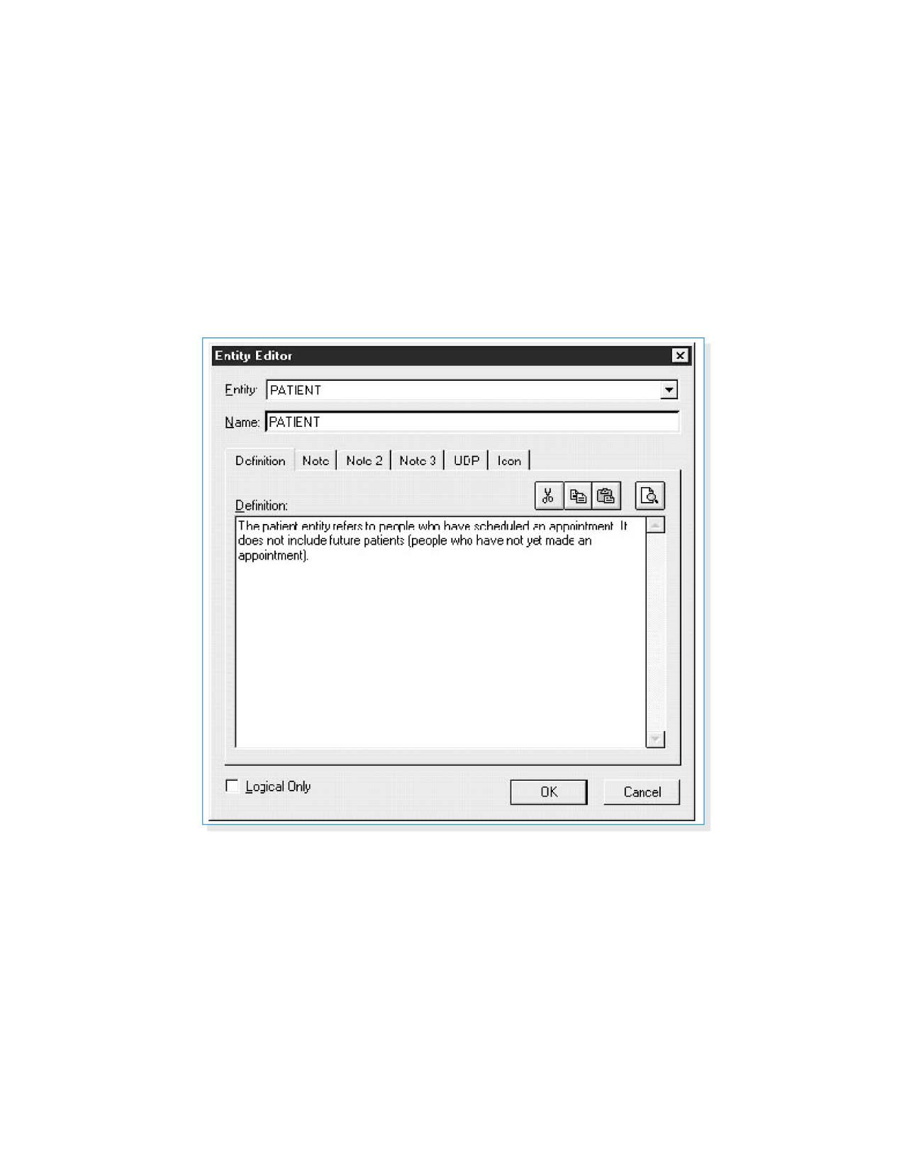
Data Dictionary Entry for the Patient Entity (Shown Using Erwin)
7 - ‹#›
PowerPoint Presentation for Dennis, Wixom, & Roth Systems Analysis and Design, 3rd Edition
Copyright 2006 © John Wiley & Sons, Inc. All rights reserved.
.

Slide 31
Exercise 1
Find the Entities and Attributes in a Simple University System
Let’s use a basic education model to practice identifying entities and attributes. We’ll imagine that university authorities have asked us to prepare a simple system for class management. They gave us the following general description:
There are many students who take up various courses. All courses are run by lecturers. We have ID numbers for students, courses and lecturers. When a new student comes, we need to know their first name, last name and date of birth. When a new lecturer comes, we write down their first name, last name and their date of employment. All courses have names and descriptions so that students know what they cover. We also store the date when the course starts.
Identify the entities and attributes in this description.

Slide 32
Exercise 2
Description:
Samuel wants to create an online restaurant guide. There are many such websites already, but he wants to focus on the particular dishes available rather than on the restaurant themselves. He’s really enthusiastic about his idea and this is how he described it to us:
I want to describe restaurants in detail on my site, so I need the basic stuff like their names and addresses. The address must be precise: not only the street and the number, but also the city, state and country. Yes, country; I want to go international! Besides, I want each of them to be given a particular style, like, you know, Chinese, Italian, or something like that. Each of them will be ranked with a certain number of stars.
More importantly, I want to focus on the food! Restaurants serve thousands of meals, and for each of them, I need the dish’s name and type – appetizer, main course, or dessert. There are various appetizers in various countries, so I need to store information about appetizer origins, too. And for main courses… well, I think it will be nice to provide the number of calories for people on diets. Desserts should also contain this sort of information.
And I want EACH dish to be shown, together with its current price! Oh, that reminds me: let’s put beverages on there too. The name, the price… and maybe the level of alcohol, come to think of it.
Based on the above description, suggest a few entities and their attributes for Samuel’s online restaurant guide.

